Slide 1
CSE2312: Computer Organization and Assembly Language Programming
Slide 1: Number Conversion (Integer)

Slide 2
Decimal/Base-10
10 digits: 0~9
The weight of digit n from the right is 10^{n}
e.g., the ‘3’ in 5326 is 3*10²

Slide 3
Binary/Base-2 (Unsigned)
2 digits: 0 and 1
The weight is exponent of 2
Weight of digit n from the right is 2^{n}
E.g., 10101010 (base-2)
1 | 0 | 1 | 0 | 1 | 0 | 1 | 0
₂7 | ₂6 | ₂5 | ₂4 | ₂3 | ₂2 | ₂1 | ₂0
MSb (the most significant bit)
LSb (the least significant bit)

Slide 4
Binary/Base-2 (Unsigned)
2 digits: 0 and 1
The weight is exponent of 2
Weight of digit n from the right is 2^{n}
E.g., 10101010 (base-2)
10101010 (base-2), 0b10101010, 10101010₂

Slide 5
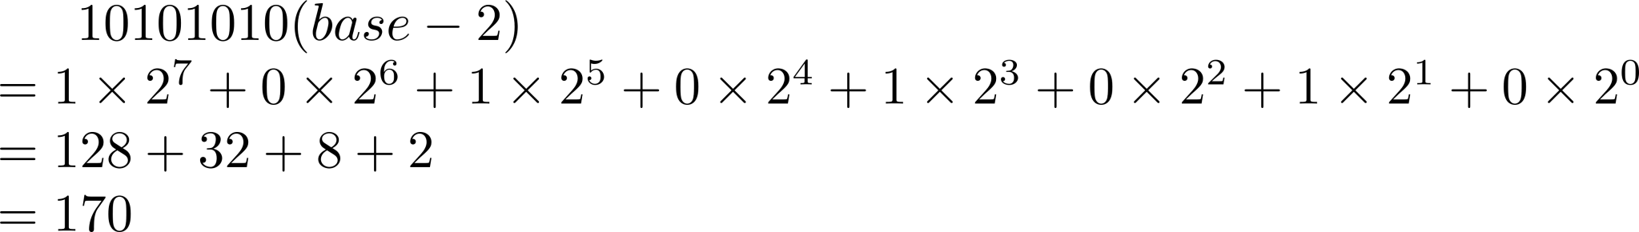
Conversion: Binary to Decimal (Unsigned)
Step 1: List the weights of all the digits
Step 2: Multiple digits by their corresponding weights
Step 3: Calculate the sum of all products
Practice: Convert 10101010 (base-2) to decimal
1 | 0 | 1 | 0 | 1 | 0 | 1 | 0
₂7 | ₂6 | ₂5 | ₂4 | ₂3 | ₂2 | ₂1 | ₂0

Slide 6
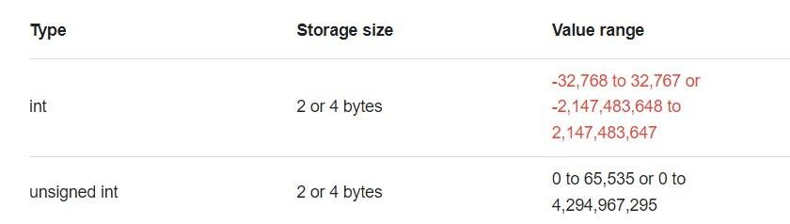
Ambiguity of type int in C language
Type int is store in binary
C language of different versions use different number of bit for int

Slide 7
Ambiguity of type int in C language
Type int is store in binary
C language of different versions use different number of bit for int
To avoid ambiguity, this course will use type int with precision (C99)
uint8_t/uint16_t/uint32_t/uint64_t: unsigned int of 8 bits/16 bits/32 bits/64 bits
int8_t/int16_t/int32_t/int64_t: signed int of 8 bits/16 bits/32 bits/64 bits

Slide 8
Range of uintN_t (Unsigned)
Range of uint8_t: 0 (0b00000000) ~255 (0b11111111)
Range of uint16_t: 0 (0b0000000000000000) ~65,535 (0b1111111111111111)
Range of uintN_t: 0 (all 0s) ~ 2^{N}-1 (all 1s)

Slide 9
Conversion: Decimal to Binary (Unsigned)
Step 0: Check whether the decimal number is within the range
Step 1: List the weights of bits at all the positions
Step 2: Compare the decimal number with weights along the direction from MSb to LSb. If the number is larger than or equal to the weight, subtract the weight from the number, put ‘1’ as the binary digit in this position, and continue with the difference. Otherwise, put ‘0’ and move on to the next weight.
Practice: Convert 53 to uint8_t

Slide 10
Conversion: Decimal to Binary
53 is within the range of uint8_t (0~255)
₂7 | ₂6 | ₂5 | ₂4 | ₂3 | ₂2 | ₂1 | ₂0
128 | 64 | 32 | 16 | 8 | 4 | 2 | 1
53 ≥ 128?
No
53 ≥ 64?
No
53 = 0b00110101
53 ≥ 32?
Yes 53-32=21
21 ≥ 16?
Yes 21-16=5
5 ≥ 8?
No
5 ≥ 4?
Yes 5-4=1
1 ≥ 2?
No
1 ≥ 1?
Yes
1-1=0
0
0
1
1
0
1
0
1

Slide 11
Conversion: Decimal to Binary
Practice: Convert 1000 to uint8_t
Answer: 1000 is larger than 255, it’s impossible

Slide 12
Hex/Base-16
16 digits: 0~9, A (10), B (11), C(12), D(13), E(14), F(15)
The weight is exponent of 16
Weight of digit n from the right is 16^{n}
E.g., the ‘A’ in ABCD (Base-16) stands for 10*16³
ABCD (Base-16), 0xABCD, ABCD₁₆

Slide 13
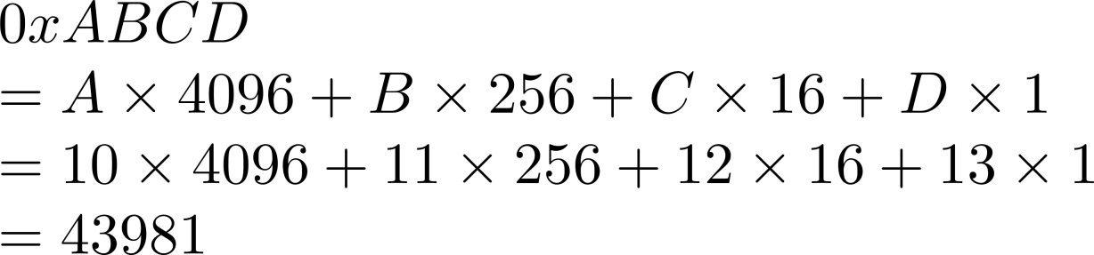
Conversion: Hex to Decimal
Step 1: List the weights of all the digits
Step 2: Multiple digits by their corresponding weights
Step 3: Calculate the sum of all products
Practice: Convert ABCD (base-16) to decimal
0x (weight)
A B C D
16³ 16² 16¹ 16⁰

Slide 14
Conversion: Hex to Binary
Solution 1
Step 1: Convert Hex to Decimal
Step 2: Convert Decimal to Binary

Slide 15
Conversion: Hex to Binary
0x0 = 0 = 0b0000
0x8 = 8 = 0b1000
0xF = 15 = 0b1111
0x8F = 143 = 0b10001111
0x8F8F = 36751 = 0b1000111110001111

Slide 16
Conversion: Hex to Binary
0x0 = 0 = 0b0000
0x8 = 8 = 0b1000
0xF = 15 = 0b1111
0x8F = 143 = 0b 1000 1111
0x8F8F = 36751 = 0b 1000 1111 1000 1111

Slide 17
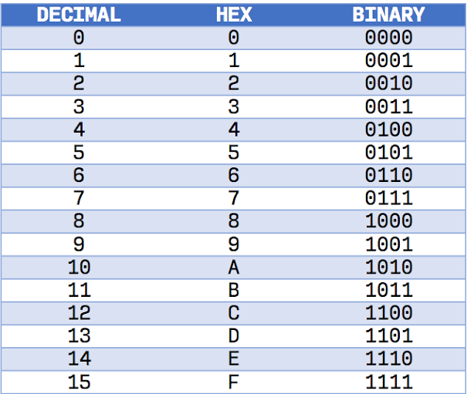
Conversion: Hex to Binary
Convert each hex digit to four binary digit and put them together
Practice: Convert ABCD to binary
0x ABCD (43981)
▪ = 0b 1010 1011 1100 1101 (43981)

Slide 18
Conversion: Binary to Hex
Step 1: Divide the binary digits to segments of four digits
Step 2: Convert every four binary digits to a hex digits, and put them together
Practice: convert 0b1000010010101001 to hex
0b 1000 0100 1010 1001
= 0x 8 4 A 9

Slide 19
Conversion: Decimal to Hex
Step 1: Convert Decimal to Binary
Step 2: Convert Binary to Hex

Slide 20
Homework Examples
Convert the following numbers between bases:
10111011 (base-2) = (base-10)
10111011 (base-2) = (base-16)
What is the range of the following C99 variable types (assuming the processor uses
two’s compliment arithmetic for signed number representation)?
uint8_t uint16_t
to
to

Slide 21
Binary/Base-2 (signed)
int8_t, int16_t, int32_t, int64_t
2’s complement coding: The weight of the MSb is negative
E.g., 10101010 (base-2)
1
-2⁷
MSb (the most significant bit)
0 | 1 | 0 | 1 | 0 | 1 0
₂6 | ₂5 | ₂4 | ₂3 | ₂2 | ₂1 ₂0
LSb (the least significant bit)

Slide 22
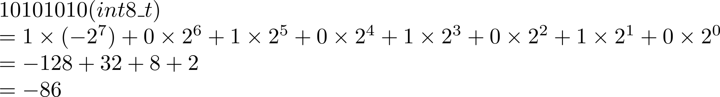
Conversion: Binary to Decimal (signed)
Step 1: List weights of all digits (MSb is negative)
Step 2: Multiply each digit by its weight
Step 3: Calculate the sum of all products
Practice: Convert 10101010 (int8_t) to decimal

Slide 23
Why both Unsigned and Signed?
Resource consideration example:
Range of int8_t: 0b10000000 (-128) ~ 0b01111111 (127)
Range of int16_t:
Range of intN_t:
-32768 ~ 32767
₋₂𝑁−1 _{~ 2}𝑁−1 ₋ ₁
Performance consideration example:
Operations on unsigned integers can be optimized differently by the hardware.
Reliability consideration example:
Using unsigned integers where only non-negative values make sense can help catch logical
errors.

Slide 24
Sign Bit (MSb)
int8_t numbers and their corresponding decimal
0b0 1 1 1 1 1 1 1
0b0 1 1 1 1 1 1 0
127
126
… …
… …
0b0 0 0 0 0 0 0 1
0b0 0 0 0 0 0 0 0
1
0
0b1 1 1 1 1 1 1 1
0b1 1 1 1 1 1 1 0
-1
-2
… …
… …
0b1 0 0 0 0 0 0 1
0b1 0 0 0 0 0 0 0
-127
-128
Sign Bit is 0 for non-negative values Sign Bit is 1 for negative values
MSB is Sign Bit

Slide 25
Conversion: Decimal to Binary (signed)
Step 0: Check whether the decimal value is within the range of the type
Step 1: List the weights of bits at all the positions (MSb is negative)
Step 2: If the decimal number is negative, put ‘1’ at the MSb, subtract the weight of the MSb (negative) from the decimal number, and move forward to step 3. Otherwise, put ‘0’ at the MSb, and move forward to step 3.
Step 3: Compare the decimal value yielded from step 2 with the weights of the remaining digits along the direction from the second most significant bit to the LSb. If the decimal value is larger than the weight, put ‘1’ at this digit, subtract the weight from the decimal value, and move on with the difference. Otherwise, move on to the next digit.
Practice: Convert -100 to int8_t

Slide 26
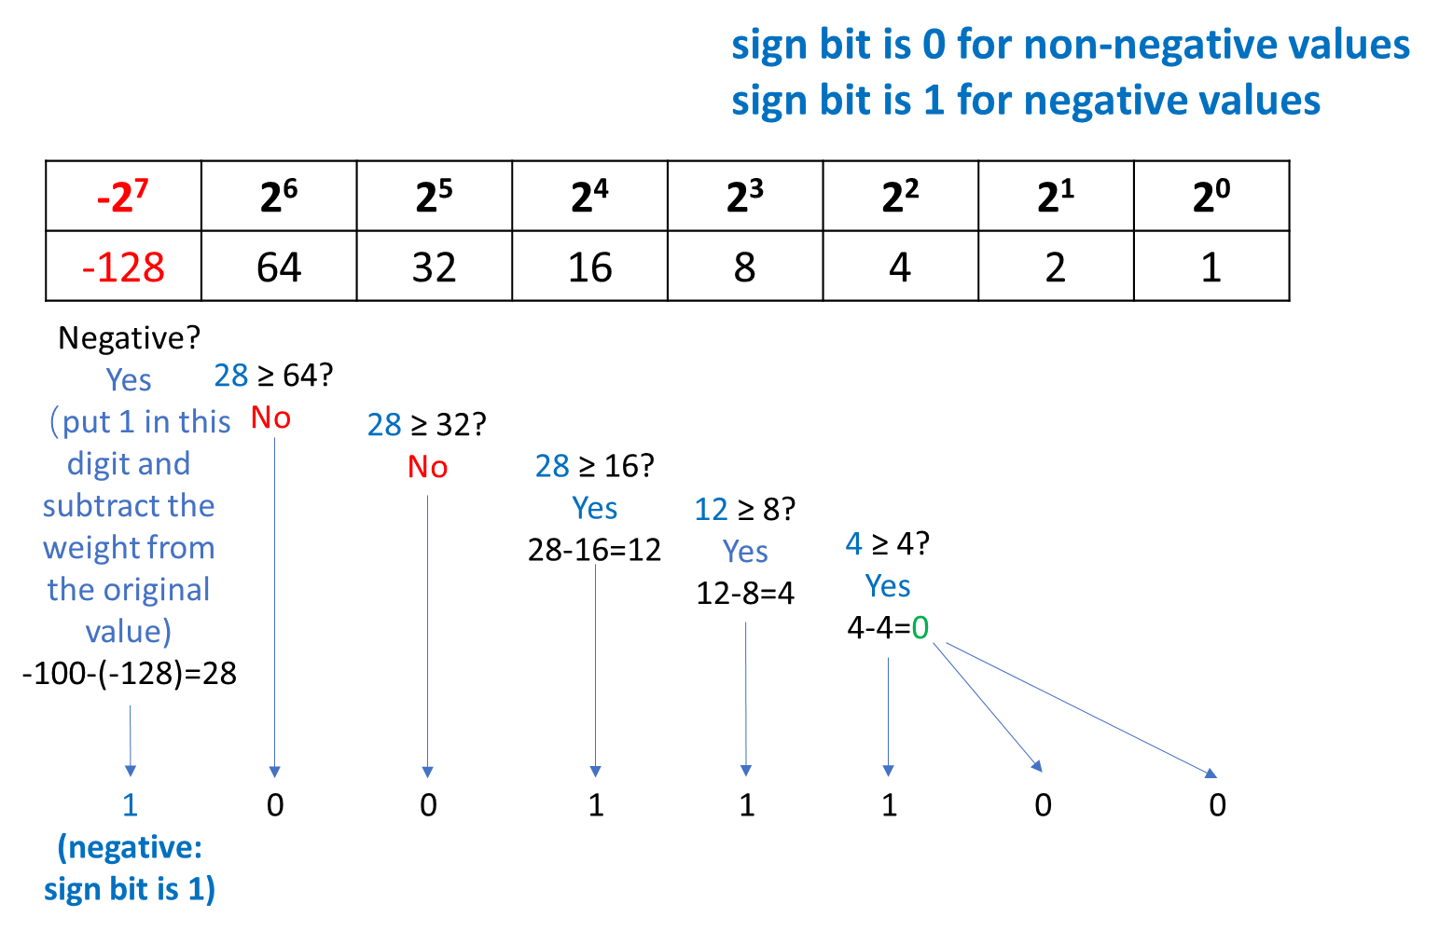
Conversion: Decimal to Binary (signed)
Practice: Convert -100 to int8_t
-100 = 0b10011100

Slide 27
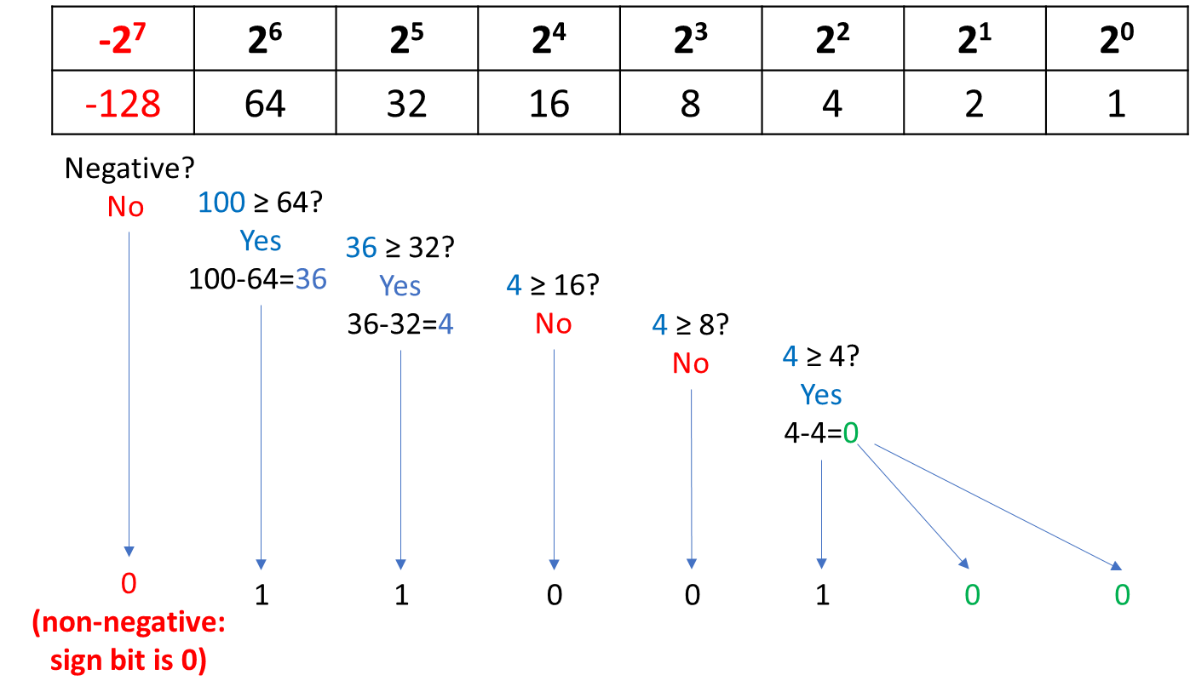
Conversion: Decimal to Binary (signed)
Practice: Convert 100 to int8_t
100 = 0b01100100

Slide 28
Benefits of 2’s Complement Coding
Given a binary number, the computer hardware does not need to know whether
it’s signed or unsigned
With 2’s complement coding, computer can calculate correctly anyway.
0b1 0 0 0 0 0 0 1 + 0b0 0 0 0 0 0 0 1
uint8_t 129 + 1 = 130
uint8_t 130
Int8_t
-127+ 1 = -126
uint8_t
-126
0b1 0 0 0 0 0 1 0

Slide 29
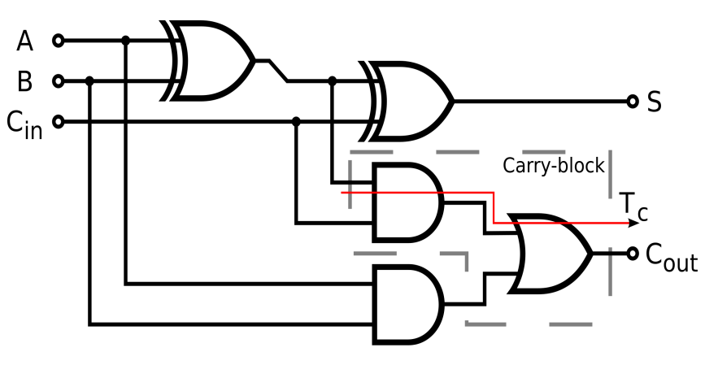
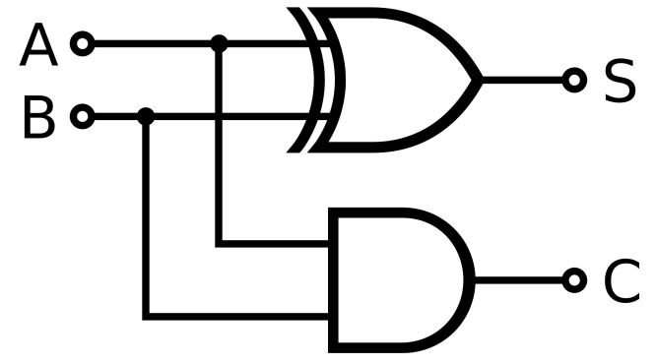
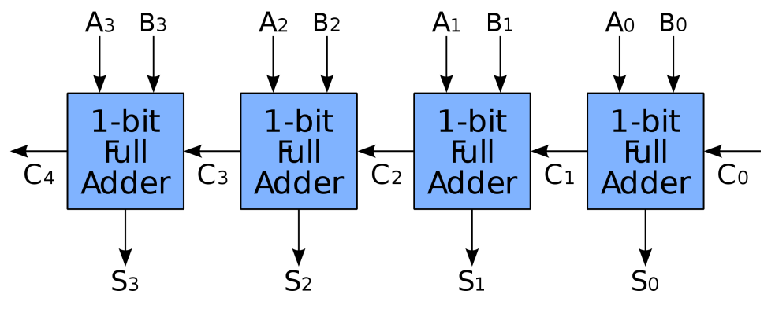
Benefits of 2’s Complement Coding
2’s Complement Coding simplifies ALU significantly.
Example of a one-bit adder:
Half Adder
Full Adder
Four bits

Slide 30
Homework Examples
Range of the following C99 variable types assuming the processor uses two’s
compliment arithmetic?
int8_t int16_t
to
to
Binary representation of the C99 variables given below? int8_t x = -40:
int8_t x = -103:

